Slide 1

Self car rental system
D.V. BY: M.ARSHAD.

Slide 2

WHAT IS IT?
SUBTITLE GOES HERE

Slide 3
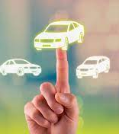
WHY I CHOSE IT.

Slide 4
USER INTERFACE:

Slide 5
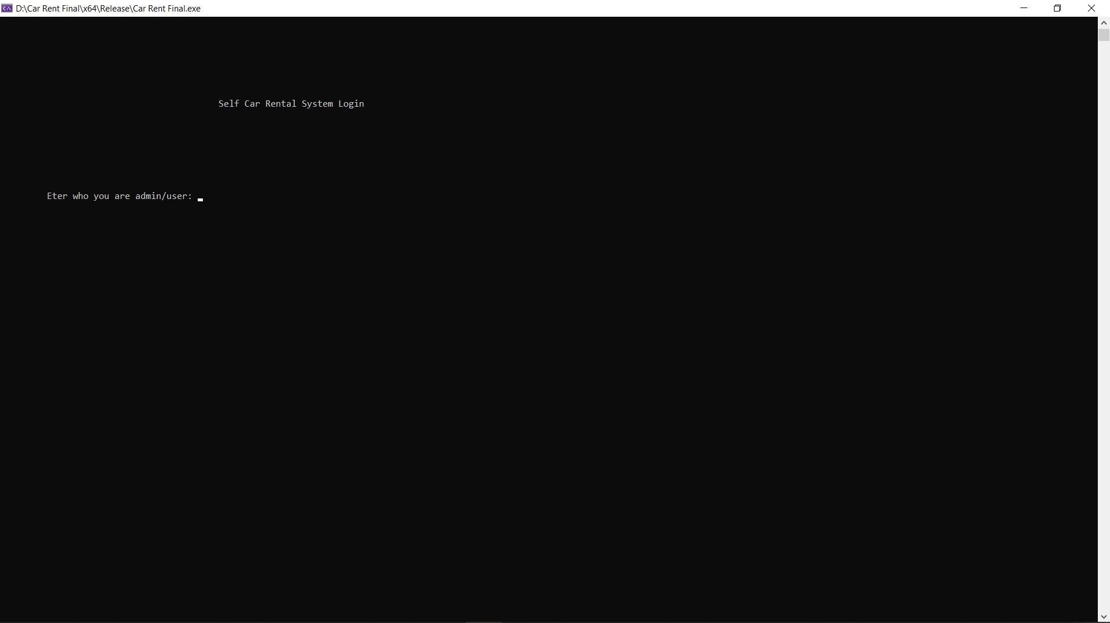
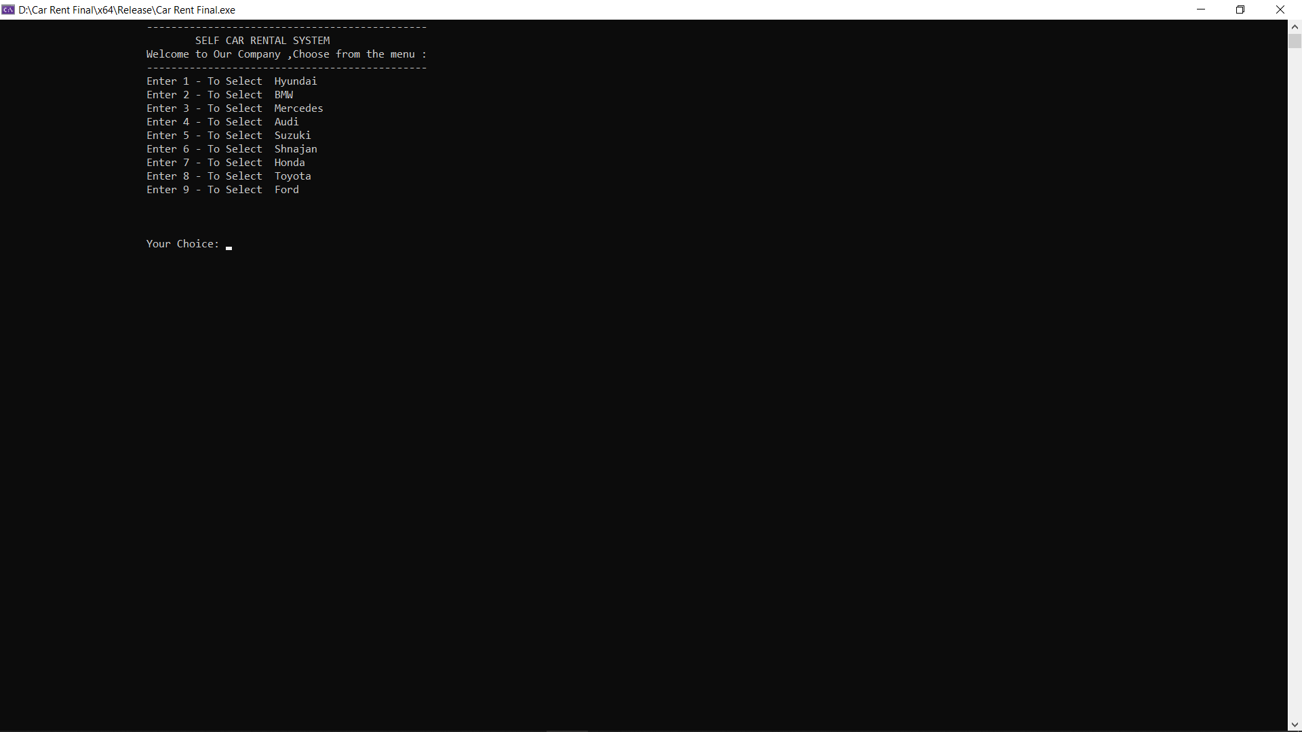

Slide 6
Admin interface:

Slide 7
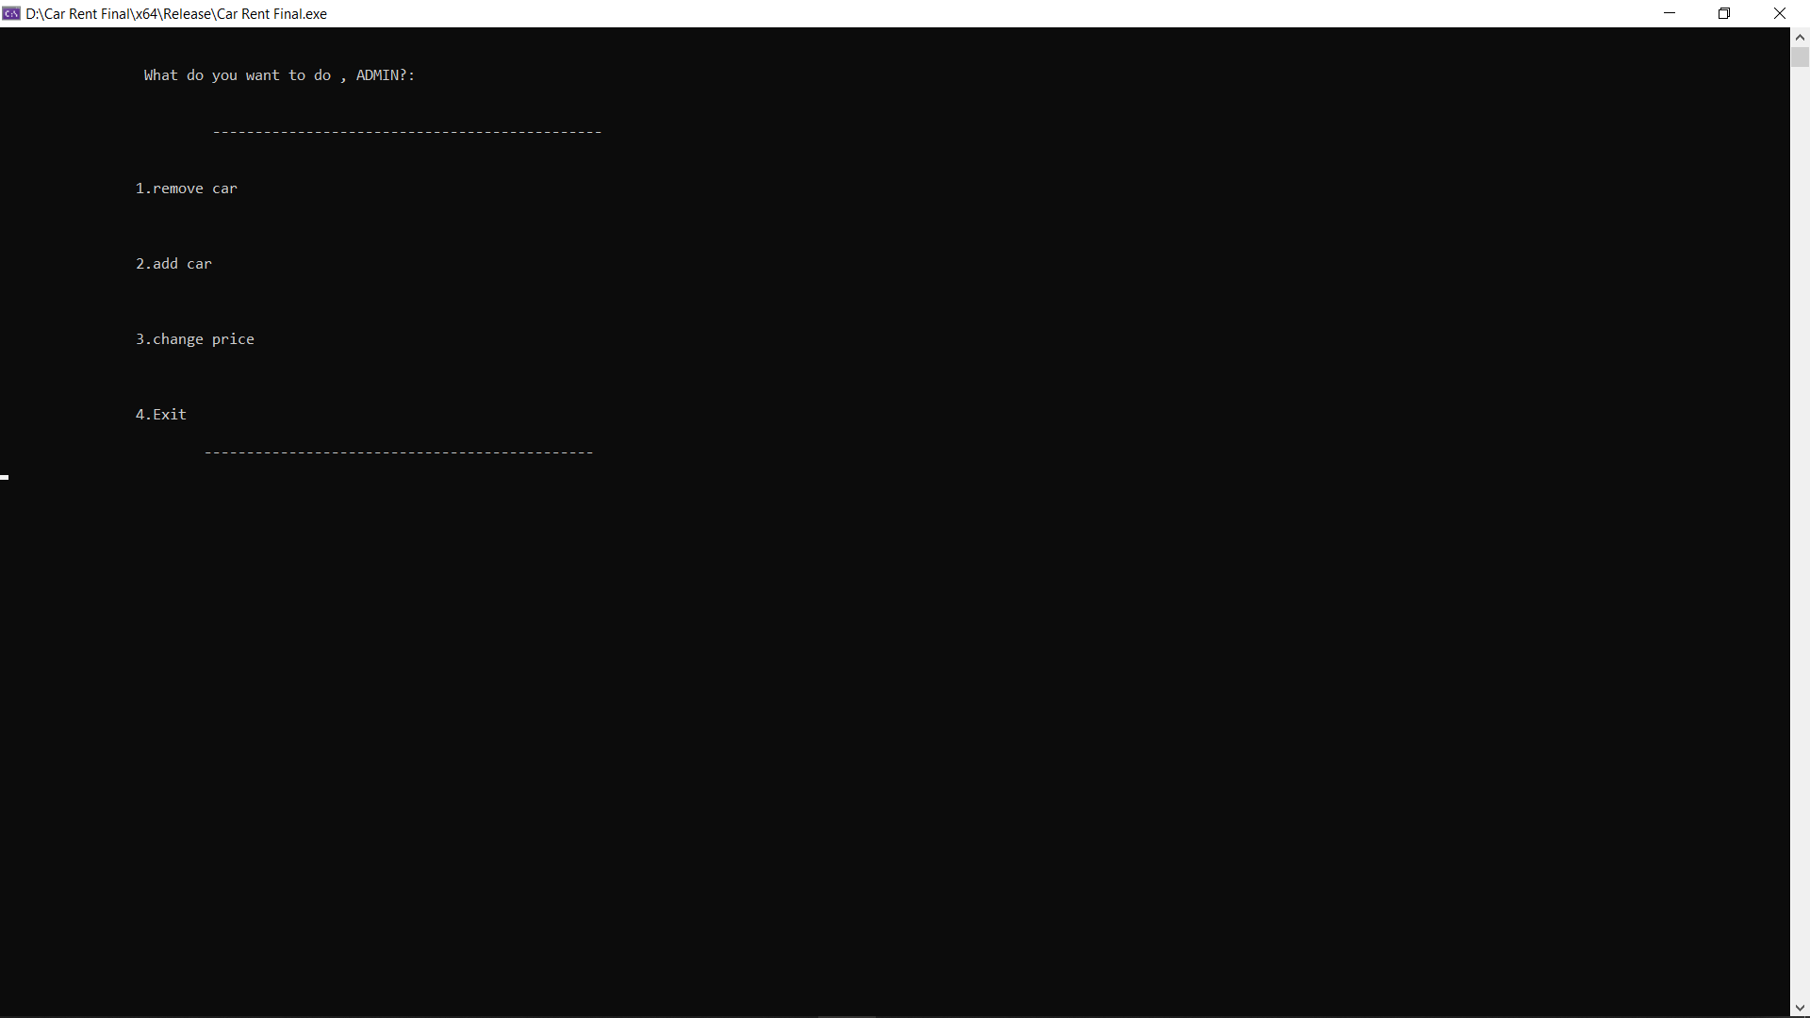
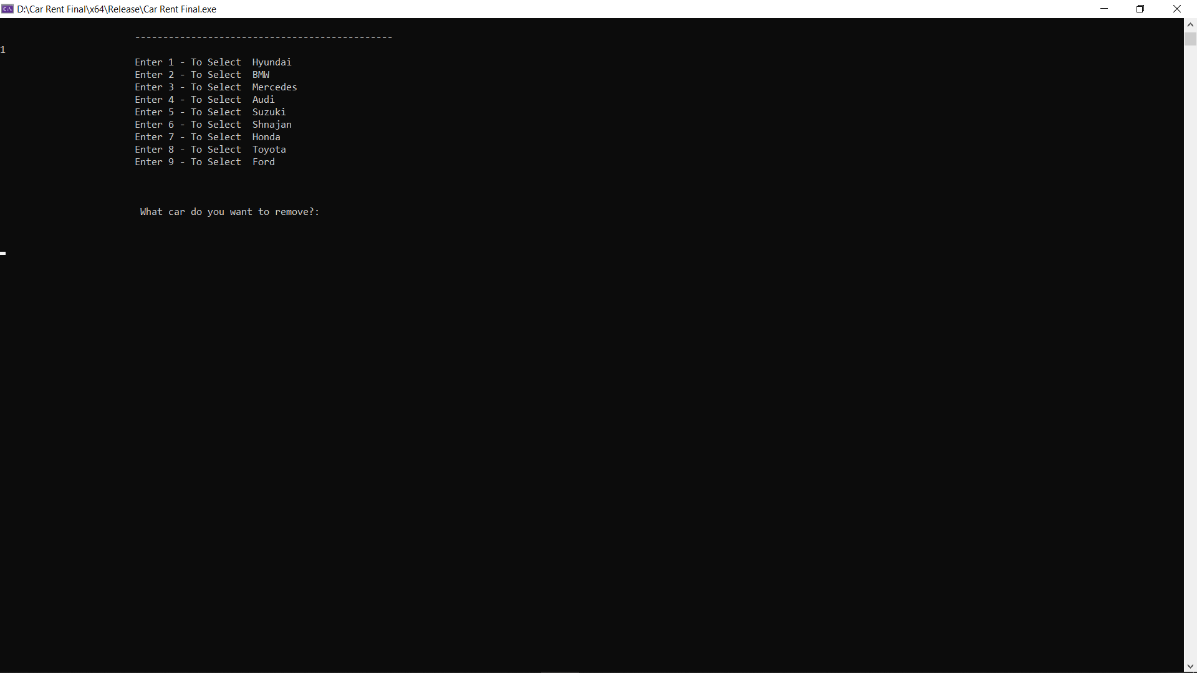

Slide 8



THANK YOU
Muhammad Arshad
+9233444474093
f2021266088@umt.edu.pk

